Slide 1
Evolution
Adapting to Change

Slide 2
Today’s Class
Quiz on Adaptions
Introduction to Natural Selection and Evolution
Natural Selection Activity

Slide 3
Evolution = the sum of all transformations undergone by a primitive life form over time

Slide 4
Natural Selection
Explains the evolution of species
Individuals whose physical and behavioral characteristics are best adapted to their habitat have a better chance to reproduce and pass on their characteristics to future generations
Charles Darwin developed the theory of Natural Selection in the 1800’s

Slide 5
The Story of the Peppered Moths
During the day these moths like to sleep on birch trunks
Which one will blend in better to the white birch’s trunk? Which one will be eaten by birds more often?

Slide 6
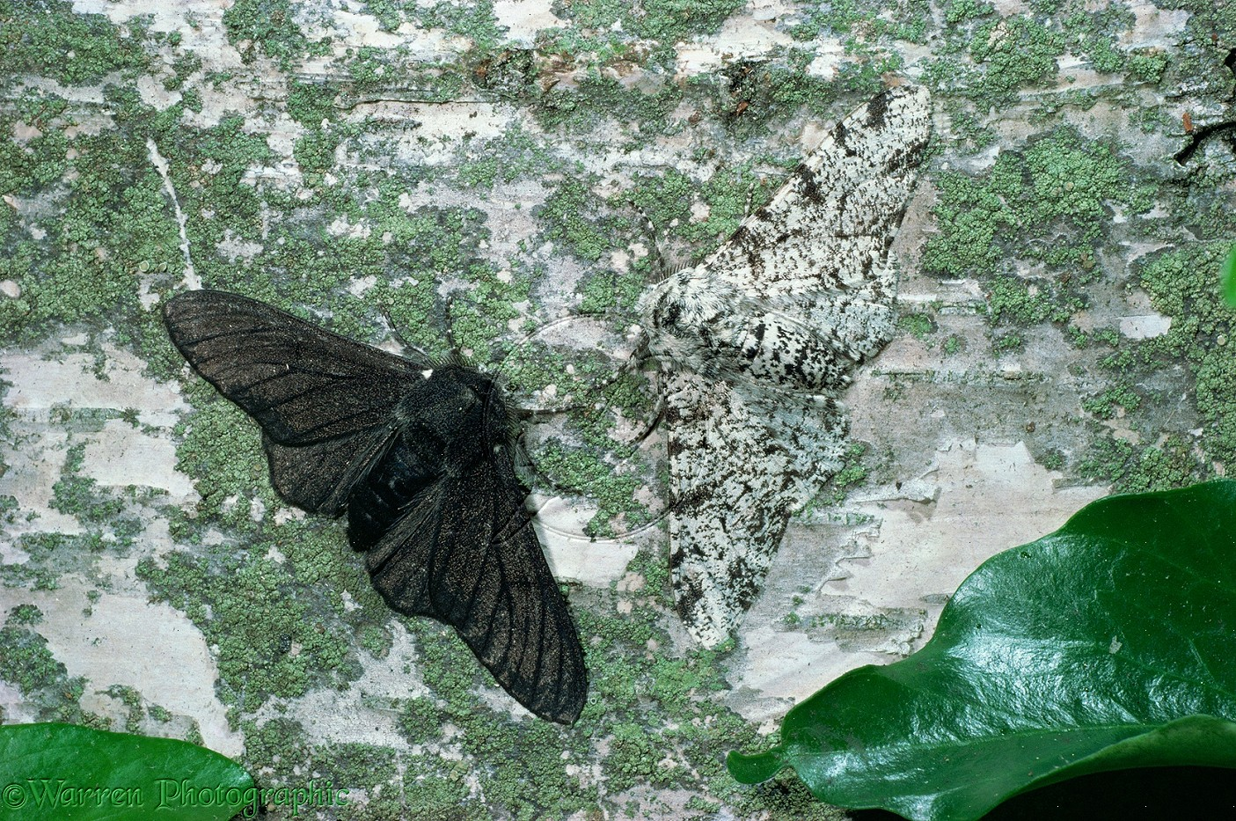

Slide 7
Now imagine a heavily polluted city where the tree trunks have turned black from all of the factory smoke… What do you think happened?

Slide 8
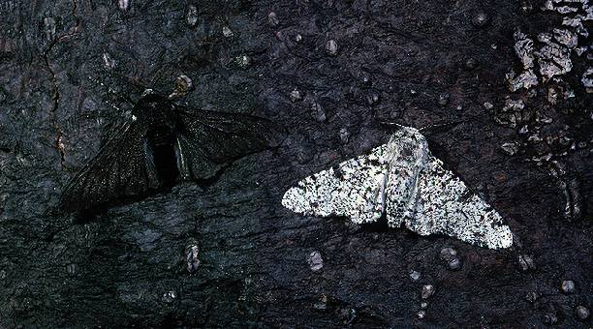
Over time…. Almost all the peppered moths would be black, since they would be the only ones to survive and therefore reproduce.
The light variation of the peppered moth is therefore best adapted to living in the country.
The dark variation is best adapted to living near factories.

Slide 9
Conclusion:
Only individuals that are well adapted to their habitat can survive and reproduce.
This is the principal of natural selection!

Slide 10
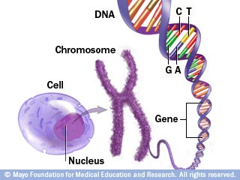
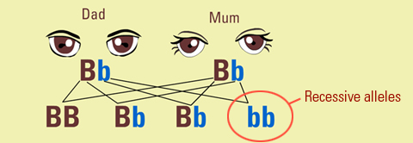
Blue or Brown Eyes?
The Blueprint of Life
Our DNA or ‘genes’ contain all of the genes required to produce an individual
Genetic mutations occur naturally.
Individuals with a beneficial mutation will have a better chance of survival and a greater chance of passing their gene mutation to their descendants.

