Slide 1
Taxonomy: Classifying Life
SCI104-01

Slide 2
New Vocabulary you will need to Record in your Notebook:
Taxonomy
Scientific Names

Slide 3
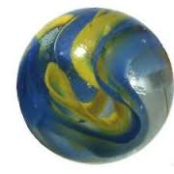
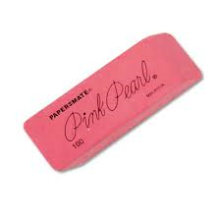
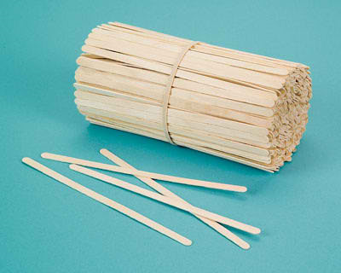
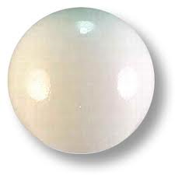
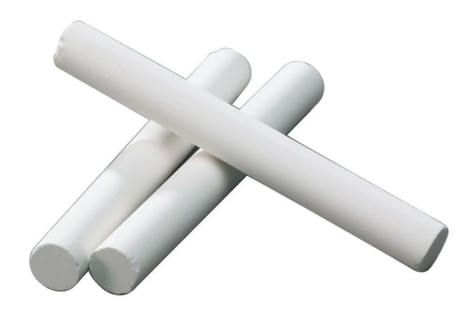
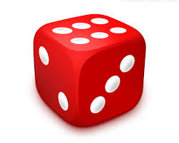
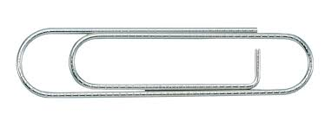
*Unmeasured items are < 10cm
13.2cm
4.3cm
18.4cm
2.9cm
19cm

Slide 4
Silly Science Activity

Slide 5
We need a way to categorize over 1.8 million species living on Earth!
The Anatomy, behaviour and fossil ancestors of a new species are studied.
Scientists compare the characteristics of the new species with those of other species that have already been named and classified.

Slide 6
Taxonomy is the classification of living organisms
“Taxis” = order
“Nomos” = law
There are six ‘Kingdoms’ of Living Organisms
ex.:Algae, amoebae
Yeasts, moulds

Slide 7
Scientific Names are used to give every species its own unique name.
Carl Linnaeus developed our current method for naming species
Example:
Sugar maple’s scientific name is:
Acer saccharum
Acer (maple) is the genus of the living organism
Saccharum (sugar) designates the species

Slide 8
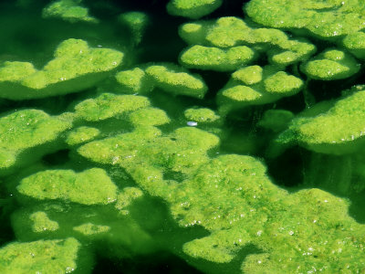
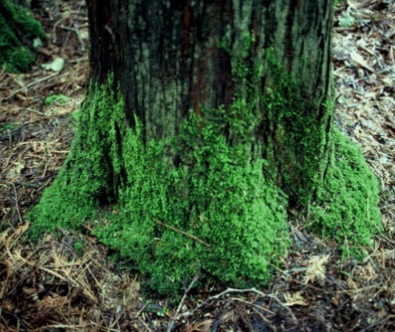
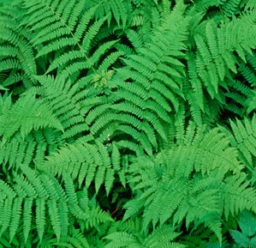
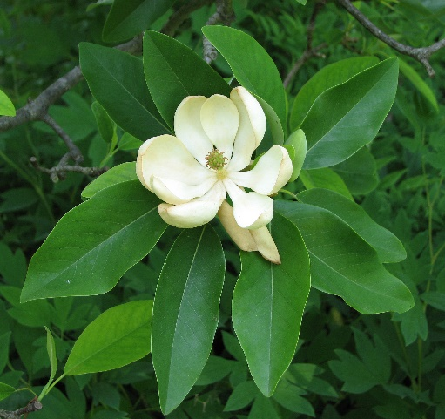
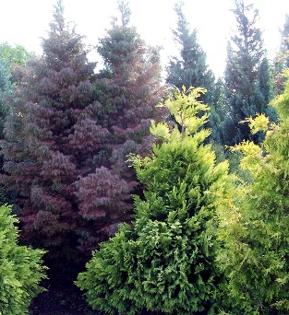
The Plant Kingdom
-they produce their own food
-they cannot move on their own

Slide 9
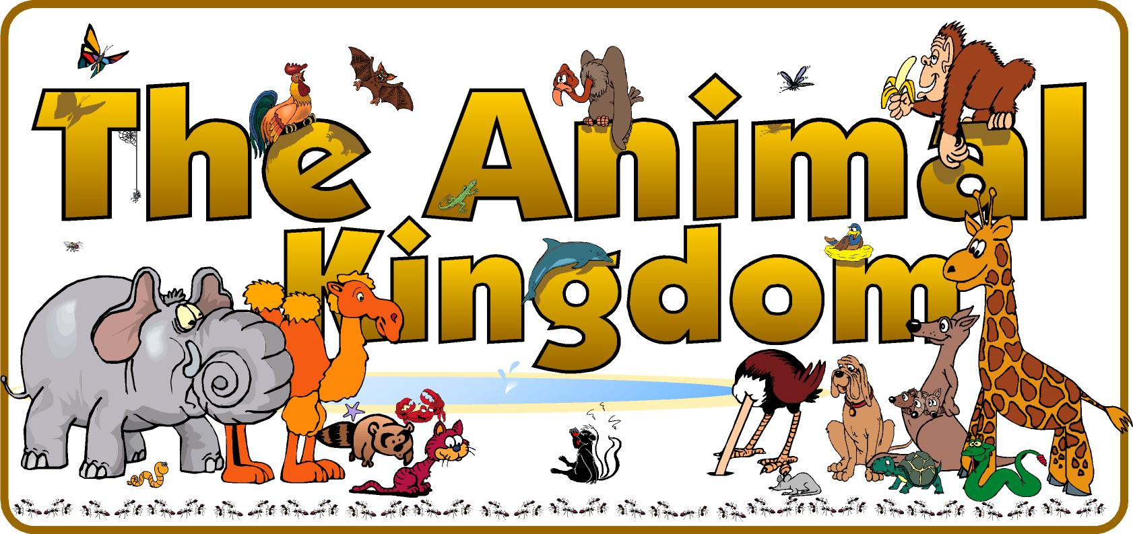
They do not produce their own food
They feed on plants or other animals
They can usually move on their own
Vertebrates ( internal skeleton)
Invertebrates (do not have an internal skeleton
Sponges
Cnidarians
Worms
Echinoderms
Mollusks
Arthropods
Cold-blooded animals
Warm-blooded animals
Fish
Amphibians
Reptiles
Birds
Mammals

Slide 10
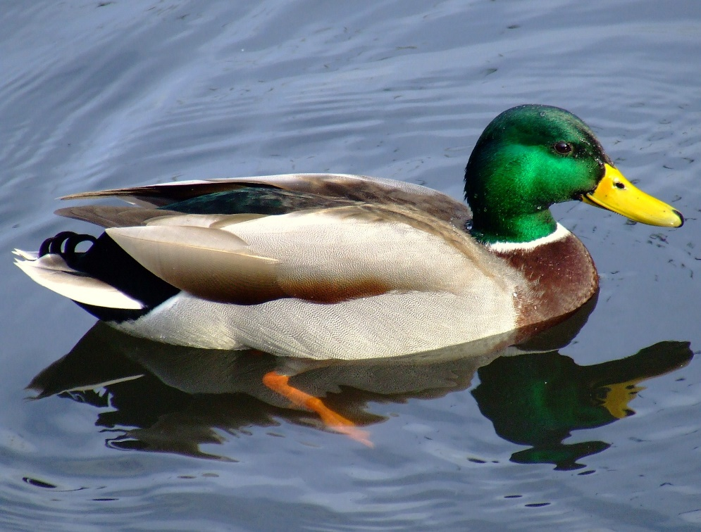
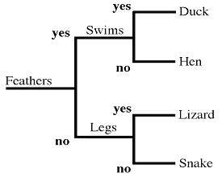
Let’s Practice Using a Dichotomous Key!

Slide 11
Let’s Try a Harder One….

Slide 12
Your Assignment:
Create your own Dichotomous Key
Assignment is due Next Class!

